Slide 1
Chapter Five
Systems Analysis

Slide 2
Topics
5.1 What Is Systems Analysis?
5.2 Systems Analysis Approaches
5.3 The Scope Definition Phase
5.4 The Problem Analysis Phase
5.5 The Requirements Analysis Phase
5.6 The Logical Design Phase
5.7 The Decision Analysis Phase
Notes:
第一部分集中于系统分析和设计的整体描述，即介绍系统分析与设计的基本概念、原理、发展趋势，它们构成系统分析与设计方法的基础
包括4章内容
第1章介绍系统分析和设计的参与者，主要强调现代系统分析员作为系统工作推进器的作用。了解到系统分析员、最终用户、管理人员和其他信息系统专家之间的关系，最后学习如何成为一名系统分析员
第2章介绍构建的产品－信息系统。将讲解如何以常用构件的方式看待信息系统：数据构件、过程构件、接口构件－每个构件都从不同的参与者和关联人员的角度来观察。引入一个矩阵框架结构组织这些构件，以便看到它们在后续章节的应用
第3章介绍一个通用的信息系统开发过程，这个过程称为系统开发生命周期，并以系统开发方法学介绍系统开发过程
第4章介绍项目管理技术。所有系统项目都依赖这些原理。并介绍项目管理的两个建模技术：甘特图和PERT图。这些工具有助于读者安排活动、评估进展和调整计划

Slide 3
5.1 What Is Systems Analysis
Systems Analysis
A problem-solving technique that decomposes a system into its component pieces for the purpose of studying how well those component parts work and interact to accomplish their purpose.
Notes:
组织并非仅由单个信息系统提供服务，而是由一群支持不同业务功能的信息系统共同提供服务。

Slide 4
5.1 What Is Systems Analysis
Systems Design
A complementary problem-solving technique that reassembles a system's component pieces back into a complete system—hopefully, an improved system.
Notes:
组织并非仅由单个信息系统提供服务，而是由一群支持不同业务功能的信息系统共同提供服务。

Slide 5
5.1 What Is Systems Analysis
Information Systems Analysis
Those development phases in an information systems development project that primarily focus on the business problem and requirements, independent of any technology that can or will be used to implement a solution to that problem.
Notes:
组织并非仅由单个信息系统提供服务，而是由一群支持不同业务功能的信息系统共同提供服务。

Slide 6
5.2 Systems Analysis Approaches
5.2.1 Model-Driven Analysis Approaches
5.2.2 Accelerated Systems Analysis Approaches
5.2.3 Requirements Discovery Methods
5.2.4 Business Process Redesign Methods
5.2.5 FAST Systems Analysis Strategies
Notes:
组织并非仅由单个信息系统提供服务，而是由一群支持不同业务功能的信息系统共同提供服务。

Slide 7
5.2.1 Model-Driven Analysis Approaches
Structured Analysis
Structured analysis focuses on the flow of data through business and software processes. It is said to be process-centered.
Process-centered mean that the emphasis is on the process building bocks in your information system framework.
Notes:
组织并非仅由单个信息系统提供服务，而是由一群支持不同业务功能的信息系统共同提供服务。

Slide 8
5.2.1 Model-Driven Analysis Approaches
Structured Analysis
Structured analysis is a model-driven, process-centered technique used to either analyze an existing system or define business requirements for a new system, or both. The models are pictures that illustrate the system's component pieces: processes and their associated inputs, outputs, and files.
——Data flow graph is used in software design.
——Business process reengineering uses various process models.
Notes:
组织并非仅由单个信息系统提供服务，而是由一群支持不同业务功能的信息系统共同提供服务。

Slide 9
5.2.1 Model-Driven Analysis Approaches
Information Engineering and Data Model
Information engineering focuses on the structure of stored data in a system. Thus, is was said to be data-centered.
Information engineering: a model-driven and data-centered, but process-sensitive, technique for planning, analyzing, and designing information systems. IE models are pictures that illustrate and synchronize the system's data and processes.
Notes:
组织并非仅由单个信息系统提供服务，而是由一群支持不同业务功能的信息系统共同提供服务。

Slide 10
5.2.1 Model-Driven Analysis Approaches
Information Engineering and Data Model
IE's data model is called an "entity relationship diagram" and defines methods for integrating and synchronizing data models and process models.
Information engineering emphasizes the need to research and analyze data requirements before analyzing and researching process requirements and interface requirements.
Before describing the data flow, first draw the entity relationship diagram and create the data model.
Notes:
组织并非仅由单个信息系统提供服务，而是由一群支持不同业务功能的信息系统共同提供服务。

Slide 11
5.2.1 Model-Driven Analysis Approaches
Object-Oriented Analysis
Object: the encapsulation of the data (called properties) with all of the processes (called methods). The only way to access or update the objects data is to use the objects predefined processes.
Notes:
组织并非仅由单个信息系统提供服务，而是由一群支持不同业务功能的信息系统共同提供服务。

Slide 12
5.2.1 Model-Driven Analysis Approaches
Object-Oriented Analysis
Object-Oriented Approach: a model-driven technique that integrates data and process concerns into constructs called objects. Object models are pictures that illustrate the system's objects from various perspectives.
Notes:
组织并非仅由单个信息系统提供服务，而是由一群支持不同业务功能的信息系统共同提供服务。

Slide 13
5.2.1 Model-Driven Analysis Approaches
Object-Oriented Analysis
Modeling standards for object-oriented analysis: Unified Modeling Language (UML), UML provides graphical syntax for the entire object model.
Notes:
组织并非仅由单个信息系统提供服务，而是由一群支持不同业务功能的信息系统共同提供服务。

Slide 14
5.2.2 Accelerated Systems Analysis Approaches
Prototype: a small-scale, incomplete, but working sample of a desired system.
Accelerated analysis emphasizes the "communication" component of the information system framework by constructing sample forms and reports.
Discovery prototyping – A technique used to identify the users' business requirements by having them react to a quick-and-dirty implementation of those requirements.
Notes:
组织并非仅由单个信息系统提供服务，而是由一群支持不同业务功能的信息系统共同提供服务。

Slide 15
5.2.2 Accelerated Systems Analysis Approaches
Rapid Architected Analysis – An approach that attempts to derive system models from existing systems or discovery prototypes.
Reverse Engineering – the use of technology that reads the program code for an existing database, application program, and/or user interface and automatically generates the equivalent system model.
Notes:
组织并非仅由单个信息系统提供服务，而是由一群支持不同业务功能的信息系统共同提供服务。

Slide 16
5.2.3 Requirements Discovery Methods
All methods of system analysis require some form of demand acquisition.
Two techniques：
Fact-Finding Techniques – the process of collecting information about system problems, opportunities, solution requirements, and priorities. Also called information gathering.
Sampling, field research, observation, consultation, and interview.
Notes:
组织并非仅由单个信息系统提供服务，而是由一群支持不同业务功能的信息系统共同提供服务。

Slide 17
5.2.3 Requirements Discovery Methods
All methods of system analysis require some form of demand acquisition.
Two techniques：
Joint Requirement Planning – the use of facilitated workshops to bring together all of the system owners, users, and analysts and some systems designers and builders to jointly perform systems analysis. JRP is generally considered a part of joint application development.
JRP is a work environment that accelerates all task analysis and delivery.
Notes:
组织并非仅由单个信息系统提供服务，而是由一群支持不同业务功能的信息系统共同提供服务。

Slide 18
5.3 The Scope Definition Phase
5.3.1 Identify Baseline Problems and Opportunities
5.3.2 Negotiate Baseline Scope
5.3.3 Assess Baseline Project Worthiness
5.3.4 Develop Baseline Schedule and Budget
5.3.5 Communicate the Project Plan
Notes:
组织并非仅由单个信息系统提供服务，而是由一群支持不同业务功能的信息系统共同提供服务。

Slide 19
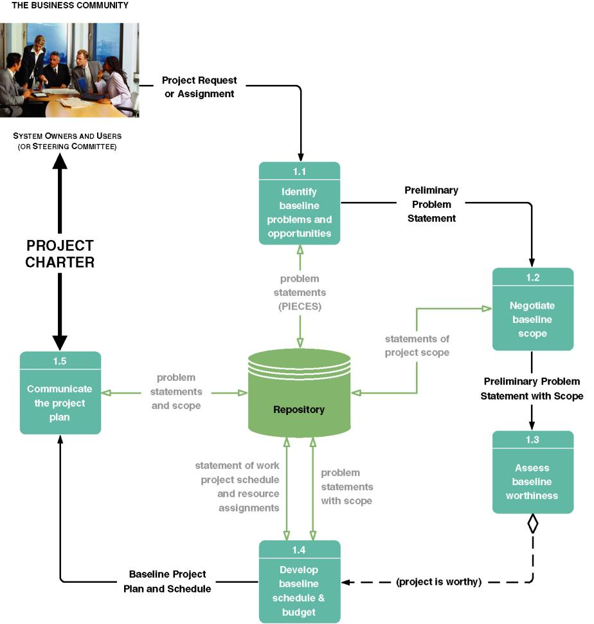
5.3 The Scope Definition Phase
Figure 5.1 Tasks for the Scope Definition Phase of Systems Analysis

Slide 20
5.3.1 Identify Baseline Problems and Opportunities
One of the most important tasks of the scope definition phase is establishing an initial baseline of the problems, opportunities, and/or directives that triggered the project. Each problem, opportunity, and directive is assessed with respect to urgency visibility, tangible benefits, and priority. Figure 5.2 is a sample document that summarizes problems, opportunities, and directives in terms of:
  Urgency
  Visibility
  Benefits
  Priority
  Possible Solutions(OPT)
Notes:
组织并非仅由单个信息系统提供服务，而是由一群支持不同业务功能的信息系统共同提供服务。

Slide 21
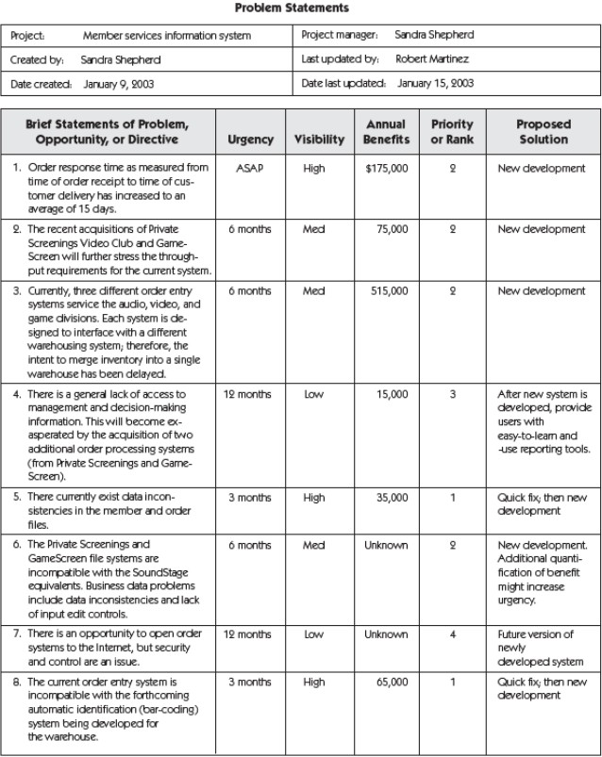
5.3.1 Identify Baseline Problems and Opportunities
Figure 5.2 Sample Problem Statements
Notes:
组织并非仅由单个信息系统提供服务，而是由一群支持不同业务功能的信息系统共同提供服务。

Slide 22
5.3.2 Negotiate Baseline Scope
Project Scope
Scope defines the boundary of the project—those aspects of the business that will and will not be included in the project. Scope can change during the project: however, the initial project plan must establish the preliminary or baseline scope.
Notes:
组织并非仅由单个信息系统提供服务，而是由一群支持不同业务功能的信息系统共同提供服务。

Slide 23
5.3.2 Negotiate Baseline Scope
Project Scope
As shown in Figure 5-6, this task uses the preliminary problem statement produced by the previous task. It should make sense that those problems, opportunities, and directives form the basis for defining scope. The statements of project scope are added to the repository for later use. These statements are also formally documented as the task deliverable, preliminary problem statement with scope.
Notes:
组织并非仅由单个信息系统提供服务，而是由一群支持不同业务功能的信息系统共同提供服务。

Slide 24
5.3.3 Assess Baseline Project Worthiness
This is where we answer the question, “Is this project worth looking at?”
As shown in Figure 5.1, the completed preliminary problem statement with scope triggers the task. This provides the level of information required for this preliminary assessment of worth. There is no physical deliverable other than the go or no-go decision. There are actually several alternative decisions. The project can be approved or canceled, and project scope can be renegotiated. Obviously, the remaining tasks in the preliminary investigation phase are necessity only if the project has been deemed worthy and approved to continue.
Notes:
组织并非仅由单个信息系统提供服务，而是由一群支持不同业务功能的信息系统共同提供服务。

Slide 25
5.3.4 Develop Baseline Schedule and Budget
The initial project plan should consist of at least the following:
A preliminary master plan that includes schedule and resource assignments for the entire project. This plan will be updated at the end of each phase of the project. It is sometimes called a baseline plan.
A detailed plan and schedule for completing the next phase of the project.
Notes:
组织并非仅由单个信息系统提供服务，而是由一群支持不同业务功能的信息系统共同提供服务。

Slide 26
5.3.4 Develop Baseline Schedule and Budget
The initial project plan should consist of at least the following:
As shown in Figure 5.1, this task is triggered by the go or no-go decision to continue the project. This decision represents a consensus agreement on the project's scope, problems, opportunities, directives, and worthiness. The problem statement with scope are the key input. The deliverable of this task is the baseline project plan and schedule.
Notes:
组织并非仅由单个信息系统提供服务，而是由一群支持不同业务功能的信息系统共同提供服务。

Slide 27
5.3.5 Communicate the Project Plan
As shown in Figure 5.1, this task is triggered by the completion of the baseline project plan and schedule. The problem statements and scope are available from the repository. The deliverable is the project charter. The project charter is usually a document. It includes various elements that define the project in terms of participants, problems, opportunities, and directives; scope; methodology; statement of work to be completed; deliverables; quality standards; schedule; and budget.
Notes:
组织并非仅由单个信息系统提供服务，而是由一群支持不同业务功能的信息系统共同提供服务。

Slide 28
5.4 The Problem Analysis Phase
5.4.1 Understand the Problem Domain
5.4.2 Analyze Problems and Opportunities
5.4.3 Analyze Business Processes
5.4.4 Establish System Improvement Objectives
5.4.5 Update or Refine the Project Plan
5.4.6 Communicate Findings and Recommendations

Slide 29
5.4 The Problem Analysis Phase
The problem analysis phase provides the analyst with a more thorough understanding of the problems, opportunities, and/or directives that triggered the project. In other methodologies, the problem analysis phase may be known as the study phase, study of the current system, detailed investigation phase, or feasibility analysis phase.
Problems to answer:
①”Are the problems really worth solving?”
②”Is a new system really worth building?”

Slide 30
5.4 The Problem Analysis Phase
Goal：To study and understand the problem domain well enough to thoroughly analyze its problems, opportunities, and constraints.
Figure 5.3 is the task diagram for the problem analysis phase. The final phase deliverable and milestone is producing system improvement objectives that address problems, opportunities, and directives.

Slide 31
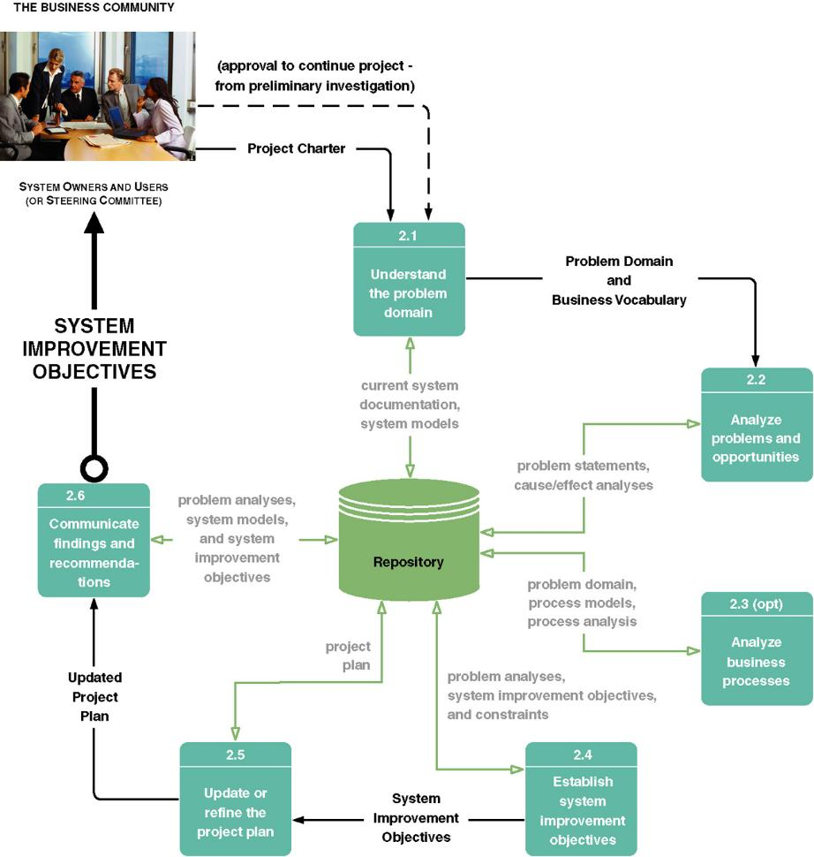
5.4 The Problem Analysis Phase
Figure 5.3 Task for the Problem Analysis Phase of System Analysis

Slide 32
5.4.1 Understand the Problem Domain
It is important to study and under-stand the problem domain, that domain in which the business problems, opportunities, directives, and constraints exist. This task will be led by the project manager but facilitated by the lead system systems analyst.
The deliverables of this task are an understanding of the problem domain and business vocabulary. There are several ways to document the problem domain:
Drawing system models of the current system;
Using information building blocks as a framework for listing and defining the system domain.
Notes:
组织并非仅由单个信息系统提供服务，而是由一群支持不同业务功能的信息系统共同提供服务。

Slide 33
5.4.1 Understand the Problem Domain
“Knowledge”—— List all the “things” about which the system currently stores data. Define each thing in business terms.
“Process”—— Define each business event for which a business response is currently implemented.
“Communications”—— Define all the locations that the current system serves and all of the users at each of those locations.
Notes:
组织并非仅由单个信息系统提供服务，而是由一群支持不同业务功能的信息系统共同提供服务。

Slide 34
5.4.1 Understand the Problem Domain
Context Diagram
The purpose of a context diagram is to analyze how the system interacts with the world around it and to specify in general terms the system inputs and outputs.
The context diagram shown in Figure 5.4 employs a hybrid approach. It employs use case symbols as use cases are becoming a generally accepted tool of the requirements analysis phase.

Slide 35
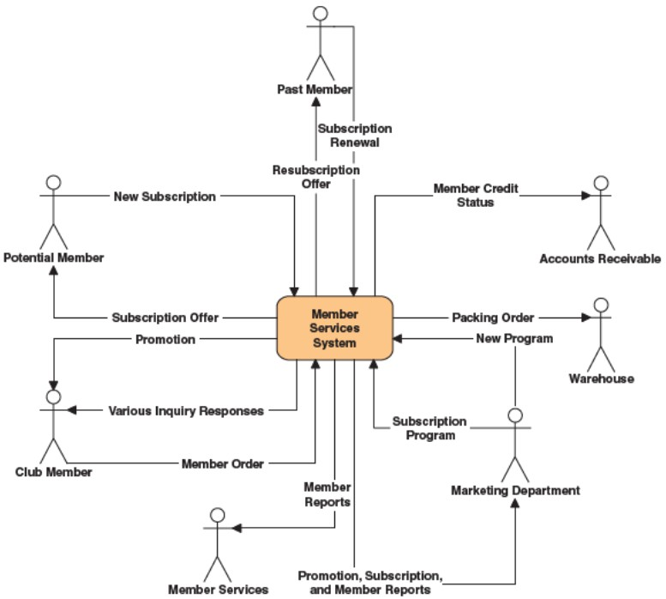
5.4.1 Understand the Problem Domain
Figure5.4 Context Diagram

Slide 36
5.4.2 Analyze Problems and Opportunities
In addition to learning about the current system, the project team must work with system owners and system users to analyze problems and opportunities.
The team's understanding of the system domain and busin115 vocabulary triggers this task. This understanding of the problem domain is crucial because the team members should not attempt to analyze problems unless they understand the domain in which those problems occur.
The other informational input to this task is the initial problem statements. The deliverables of this task are the updated problem statements and the cause-effect analysis for each problem and opportunity.
Notes:
组织并非仅由单个信息系统提供服务，而是由一群支持不同业务功能的信息系统共同提供服务。

Slide 37
5.4.3 Analyze Business Processes
This task is appropriate only to business process redesign (BPR) projects or system development projects that build on or require significant business process redesign.
As depicted in Figure 5.3, a business process analysis task is dependent only on some problem domain knowledge. The deliverables of this task are business "as is" process models and process analyses. The process models can look very much like data flow diagrams except they are significantly annotated to show
1） The volume of data flowing through the processes
2）The response times of each process
3）Any delays or bottlenecks that occur in the system
Notes:
组织并非仅由单个信息系统提供服务，而是由一群支持不同业务功能的信息系统共同提供服务。

Slide 38
5.4.4 Establish System Improvement Objectives
The purpose of this task is to establish the criteria against which any improvements to the system will be measured and to identify any constraints that may limit flexibility in achieving those improvements.
The criteria for success should be measured in terms of objectives. Objectives represent the first attempt to establish expectations for any new system.
Notes:
组织并非仅由单个信息系统提供服务，而是由一群支持不同业务功能的信息系统共同提供服务。

Slide 39
5.4.4 Establish System Improvement Objectives
System improvement objectives should be precise.
In addition to identifying objectives, we must also identify any known constraints. Constraints place limitations or delimitations on achieving objectives. Deadlines, budgets, and required technologies are examples of constraints.
Constraints fall into 4 categories: schedule, cost, technology, policy.
Notes:
组织并非仅由单个信息系统提供服务，而是由一群支持不同业务功能的信息系统共同提供服务。

Slide 40
5.4.5 Update or Refine the Project Plan
Project Scope
Project scope is a moving target. Based on our baseline schedule and budget from the scope definition phase, scope may have grown or diminished in size and complexity. We should reevaluate project scope and update or refine the project plan accordingly.
The techniques and steps for updating the project plan were taught in Chapter 4.
Notes:
组织并非仅由单个信息系统提供服务，而是由一群支持不同业务功能的信息系统共同提供服务。

Slide 41
5.4.6 Communicate Findings and Recommendations
As with the scope definition phase, the problem analysis phase concludes with a communication task.
We must communicate findings and recommendations to the business community.
An outline for a written report is shown in Figure 5-13, it does not involve technical solutions.
One of the following decisions must be made: authorize the project to continue, adjust the scope, or cancel the project.
Notes:
组织并非仅由单个信息系统提供服务，而是由一群支持不同业务功能的信息系统共同提供服务。

Slide 42
5.5 The Requirement Analysis Phase
5.5.1 Identify and Express System Requirements
5.5.2 Prioritize System Requirements
5.5.3 Update or Refine the Project Plan
5.5.4 Communicate the Requirements Statement
5.5.5 Ongoing Requirement Management
Notes:
组织并非仅由单个信息系统提供服务，而是由一群支持不同业务功能的信息系统共同提供服务。

Slide 43
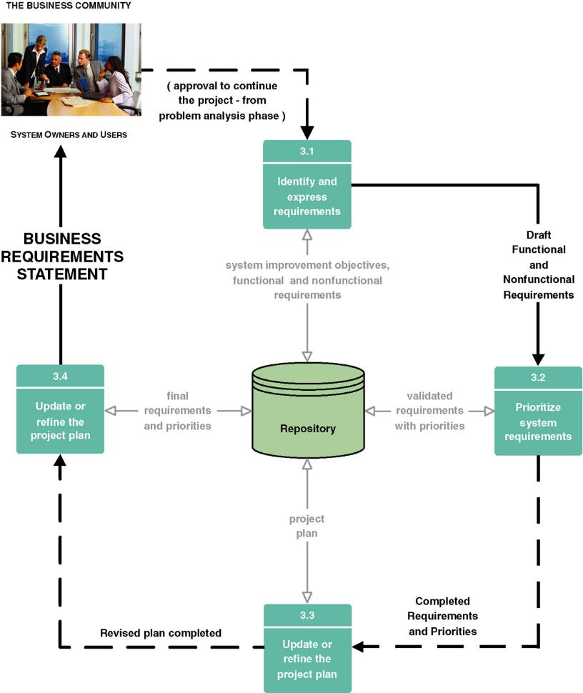
5.5 The Requirement Analysis Phase
Figure 5.5 Tasks for the Requirements Analysis Phase of Systems Analysis

Slide 44
5.5.1 Identify and Express System Requirements
The initial task of the requirements analysis phase is to identify and express requirements.
Functional requirements: a description of activities and services a system must provide.
Nonfunctional requirements: a description of other features, characteristics, and constraints that define a satisfactory system.
The only deliverable of this task is the draft functional and nonfunctional requirements.
Use case is introduced to express requirements.
Notes:
组织并非仅由单个信息系统提供服务，而是由一群支持不同业务功能的信息系统共同提供服务。

Slide 45
5.5.2 Prioritize System Requirements
Given the validated requirements, system owners and users should prioritize system requirements.
Prioritization of requirements can be facilitated using a popular technique called timeboxing.
Priorities can be classified according to their relative importance:
  A mandatory requirement
  A desirable requirement
Notes:
组织并非仅由单个信息系统提供服务，而是由一群支持不同业务功能的信息系统共同提供服务。

Slide 46
5.5.3 Update or Refine the Project Plan
The team must consider the possibility that the new system may be larger than originally expected. If so, the team must adjust the schedule, budget, or scope accordingly.
Notes:
组织并非仅由单个信息系统提供服务，而是由一群支持不同业务功能的信息系统共同提供服务。

Slide 47
5.5 The Requirement Analysis Phase
5.5.4 Communicate the Requirements Statement
5.5.5 Ongoing Requirement Management
Notes:
组织并非仅由单个信息系统提供服务，而是由一群支持不同业务功能的信息系统共同提供服务。

Slide 48
5.6 The Logical Design Phase
5.6.1 Structure Functional Requirements
5.6.2 Prototype Functional Requirements
5.6.3 Validate Functional Requirements
5.6.4 Define Acceptance Test Cases
Notes:
组织并非仅由单个信息系统提供服务，而是由一群支持不同业务功能的信息系统共同提供服务。

Slide 49
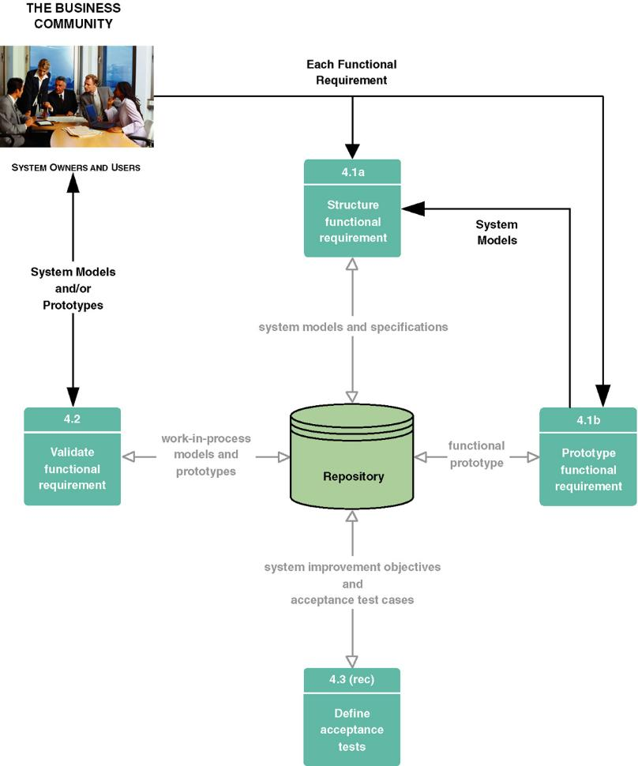
5.6 The Logical Design Phase
Figure 5.6 Tasks for the Logical Design Phase of Systems Analysis

Slide 50
5.7 The Decision Analysis Phase
5.7.1 Identify Candidate Solutions
5.7.2 Analyze Candidate Solutions
5.7.3 Compare Candidate Solutions
5.7.4 Update the Project Plan
5.7.5 Recommend a System Solution
Notes:
组织并非仅由单个信息系统提供服务，而是由一群支持不同业务功能的信息系统共同提供服务。

Slide 51
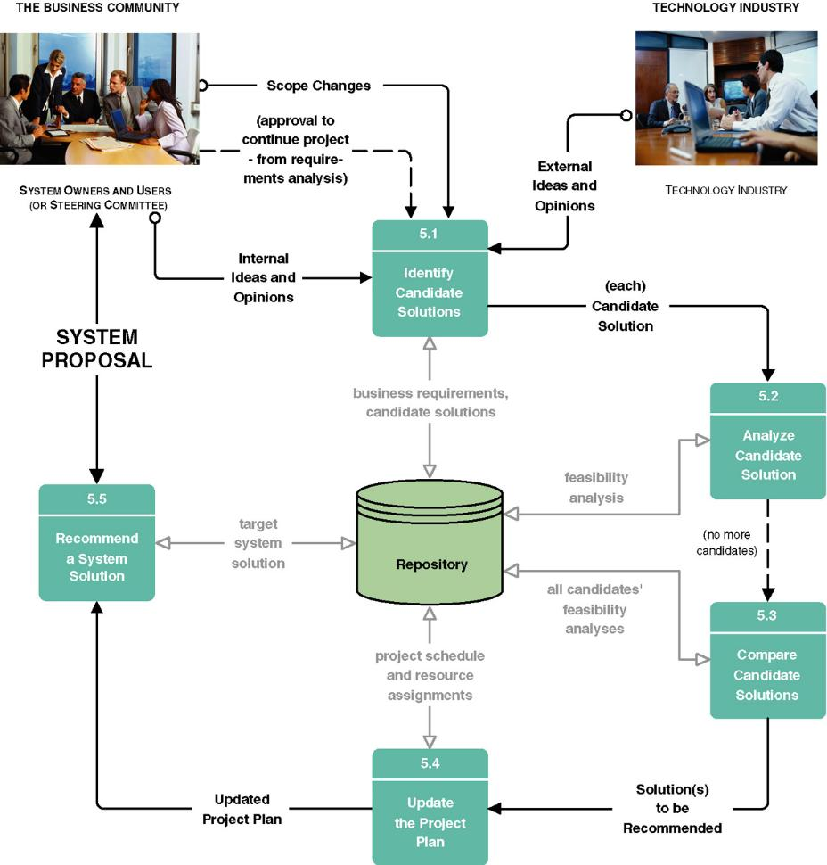
5.7 The Decision Analysis Phase
Figure 5.7 Tasks for the Decision Analysis Phase of Systems Analysis
Notes:
组织并非仅由单个信息系统提供服务，而是由一群支持不同业务功能的信息系统共同提供服务。

Slide 52
5.7.1 Identify Candidate Solutions
In addition to coming from the project team itself, ideas and opinions can be generated from both internal and external sources. Each idea generated is considered to be a candidate solution to the business requirements.
The amount of information describing the characteristics of any one candidate solution may become overwhelming. A candidate matrix, such as Figure 5.8, is a useful tool for effectively capturing, organizing, and comparing the characteristics of different candidate solutions.
Notes:
组织并非仅由单个信息系统提供服务，而是由一群支持不同业务功能的信息系统共同提供服务。

Slide 53
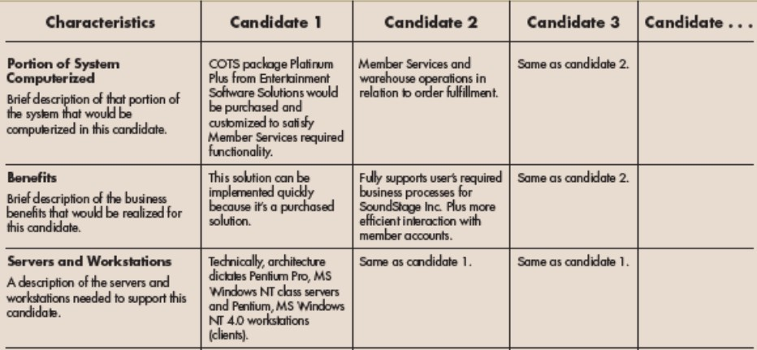
5.7.1 Identify Candidate Solutions
Figure 5.8 A Candidate Matrix
Notes:
组织并非仅由单个信息系统提供服务，而是由一群支持不同业务功能的信息系统共同提供服务。

Slide 54
5.7.2 Analyze Candidate Solutions
Each candidate system solution must be analyzed for feasibility. Feasibility analysis should not be limited to costs and benefits. Most analysts evaluate solutions against at least four sets of criteria:
  Technical feasibility
  Operational feasibility
  Economic feasibility
  Schedule feasibility
Notes:
组织并非仅由单个信息系统提供服务，而是由一群支持不同业务功能的信息系统共同提供服务。

Slide 55
5.7.3 Compare Candidate Solutions
Any infeasible candidates are usually eliminated from further consideration.
We will identify and recommend the candidate that offers the best overall combination of technical, operational, economic, and schedule feasibilities. It should be noted that in selecting such a candidate, it is rare that a given candidate is found to be the most operational, technical, economic, and schedule feasible.
Notes:
组织并非仅由单个信息系统提供服务，而是由一群支持不同业务功能的信息系统共同提供服务。

Slide 56
5.7.4 Update the Project Plan
We are continually updating our project plan as we learn more about a system, its problems, its requirements, and its solutions. We are adjusting scope accordingly. Thus, based on our recommended solution(s), we should once again reevaluate project scope and update the project plan accordingly
As shown in Figure 5.7, the updated project plan is the key output, it should now include a detailed plan for the system design phase that will follow.
Notes:
组织并非仅由单个信息系统提供服务，而是由一群支持不同业务功能的信息系统共同提供服务。

Slide 57
5.7.5 Recommend a System Solution
This task is triggered by the completion of the updated project plan. The target system solution is reformatted for presentation as a system proposal. An outline for a written report is shown in Figure 5.9.
Notes:
组织并非仅由单个信息系统提供服务，而是由一群支持不同业务功能的信息系统共同提供服务。

Slide 58
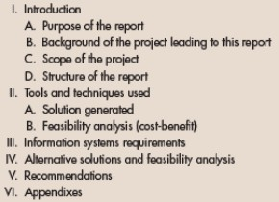
5.7.5 Recommend a System Solution
Figure 5.9 An Outline for a Typical System Proposal
Notes:
组织并非仅由单个信息系统提供服务，而是由一群支持不同业务功能的信息系统共同提供服务。

Slide 59
5.8 The future of system analysis
CASE Technology
RAD Technology
RAD and CASE tools interoperate
OO Analysis

